Slide 1
DATABASE QUERY LANGUAGES
Introduction to;
  SQL.
  Data Definition Language (DDL)
  Data Manipulation Language (DML)

Slide 2
OBJECTIVES
Introduction to SQL: Data Definition & Data Manipulation
Why SQL??
Writing SQL commands – The rules of the game
Creating Tables and Populating them with data (DML)
Retrieving data from the tables
  Projection and Selection Operations
SELECT
  Use of DINSTINCT
  Calculated Fields
Search (Using WHERE clause)
  Compound Search
  Range Search
GIT 1201

Slide 3
ADDITIONAL READING SOURCES
W3 Schools
  http://www.w3schools.com/SQL/default.asp
  Database Systems, “A practical Approach to Design, Implementation, and Management”, Fourth Edition By Conolly & Begg. ISBN: 0-321-21025-5
GIT 1201

Slide 4
INTRODUCTION
Purpose and importance of SQL.
How to update database using INSERT, UPDATE, and DELETE.
How to retrieve data from database using SELECT and:
  Use compound WHERE conditions.
  Sort query results using ORDER BY.
  Use aggregate functions.
  Group data using GROUP BY and HAVING.
  Use sub-queries.
GIT 1201

Slide 5
UNDERSTANDING SQL
Ideally, database languages should allow users to:
  create the database and relation structures;
  perform insertion, modification, deletion of data from relations;
  perform simple and complex queries.
Must perform these tasks with minimal user effort and command structure/syntax must be easy to learn.
It must be portable.
NB: Structured Query Language, an international standard for database manipulation.
GIT 1201

Slide 6
UNDERSTANDING SQL CONT’D
Query language used with relational databases
It is not a DBMS rather it is a means to communicate to the a DBMS
SQL is a transform-oriented language or
A language designed to transform input tables into required output tables with 2 major components:
  A DDL for defining database structure.
  A DML for retrieving and updating data.
When SQL statements are executed, the statements transform tables.
GIT 1201

Slide 7
UNDERSTANDING SQL CONT’D
  SQL statements start with a table,
  process that table in some way, and
  then place the results in another table structure.
  Even if the result of the processing is just a single number,
  that number is considered to be a table with one row and one column.
GIT 1201

Slide 8
CHARACTERISTICS OF SQL
SQL is relatively easy to learn:
  it is non-procedural - you specify what information you require, rather than how to get it;
Can be used by range of users including DBAs, management, application developers, and other types of end users.
An ISO standard now exists for SQL, making it both the formal and de facto standard language for relational databases.
GIT 1201

Slide 9
UNDERSTANDING SQL CONT’D
NB: A de facto standard is a custom, convention, product, or system that has achieved a dominant position by public acceptance or market forces.
Whereas A de jure standard is a standard that has been established by law
Consists of standard English words: used to query, insert, update or delete data
  1) CREATE TABLE Staff(staffNo VARCHAR(5),
    lName VARCHAR(15),
    salary DECIMAL(7,2));
GIT 1201

Slide 10
UNDERSTANDING SQL CONT’D
  2) INSERT INTO Staff VALUES (‘SG16’, ‘Brown’, 8300);
  3) SELECT staffNo, lName, salary
  FROM Staff
  WHERE salary > 10000;
GIT 1201

Slide 11
HISTORY OF SQL
In 1974, D. Chamberlin (IBM San Jose Laboratory) defined language called ‘Structured English Query Language’ (SEQUEL).
A revised version, SEQUEL/2, was defined in 1976 but name was subsequently changed to SQL for legal reasons.
Still pronounced ‘see-quel’, though official pronunciation is ‘S-Q-L’.
IBM subsequently produced a prototype DBMS called System R, based on SEQUEL/2.
GIT 1201

Slide 12
HISTORY OF SQL
Roots of SQL, however, are in SQUARE (Specifying Queries as Relational Expressions), which predates System R project.
In late 70s, ORACLE appeared and was probably first commercial RDBMS based on SQL.
In 1987, ANSI and ISO published an initial standard for SQL.
In 1989, ISO published an addendum that defined an ‘Integrity Enhancement Feature’.
In 1992, first major revision to ISO standard occurred, referred to as SQL2 or SQL/92.
GIT 1201

Slide 13
HISTORY OF SQL…
In 1999, SQL:1999 was released with support for object-oriented data management.
In late 2003, SQL:2003 was released which incorporated some object-oriented concepts
SQL:2008 in 2008.
SQL is not a complete programming language, like Java or C#.
Instead, it is called a data sublanguage
It has only the statements needed for creating and processing database data and metadata.
GIT 1201

Slide 14
IMPORTANCE OF SQL
SQL has become part of application architectures such as IBM’s Systems Application Architecture.
It is strategic choice of many large and influential organizations (e.g. X/OPEN).
SQL has become Federal Information Processing Standard (FIPS) to which conformance is required for all sales of databases to American Government.
SQL is used in other standards and even influences development of other standards as a definitional tool.
GIT 1201

Slide 15
IMPORTANCE OF SQL…
Examples include:
  ISO’s Information Resource Directory System (IRDS) Standard
      A U.S. Federal Information Processing Standard, and a Working Document of the International Organization for Standardization (ISO)
  Remote Data Access (RDA) Standard.
      Provides standard protocols for establishing a remote connection between a database client and a database server.
GIT 1201

Slide 16
IMPORTANCE OF SQL…
The ISO SQL standard does not use the formal terms of;
  relations,
  attributes, and
  tuples,
It uses the terms tables, columns, and rows.
In the presentation of SQL, mostly use the ISO terminology
GIT 1201

Slide 17
WRITING SQL COMMANDS
SQL statements consist of reserved words and user-defined words.
  Reserved words - a fixed part of SQL and must be spelt exactly as required and cannot be split across lines.
    E.g. column, date, count e.t.c.
  User-defined words - made up by user (according to certain syntax rules), and represent names of various database objects such as;
    relations, columns, views.
GIT 1201

Slide 18
WRITING SQL COMMANDS…
  Most components of an SQL statement are case insensitive unless indicated, except for literal character data.
  Character strings and dates in the where clause must be enclosed in single quotation marks (‘ ‘).
  Numeric constants should not be enclosed in single quotation marks.
If we store a person’s surname as ‘SMITH’ and then search for it using the string ‘Smith’, the row will not be found.
GIT 1201

Slide 19
WRITING SQL COMMANDS…
The words in a statement are also built according to a set of syntax rules.
Although the standard does not require it,
Many dialects of SQL require the use of a statement terminator to mark the end of each SQL statement
  Usually the semicolon ‘;’ is used.
GIT 1201

Slide 20
LITERAL
Literals are constants used in SQL statements
All non-numeric literals must be enclosed in single quotes i.e.
  dates and character strings (e.g. ‘London’).
All numeric literals must not be enclosed in quotes
  e.g. 650.00.
A literal character is a character, number or date included in a SELECT list.
GIT 1201

Slide 21
WRITING SQL COMMANDS CONT’D
More readable with indentation and lineation:
  Each clause should begin on a new line.
  Start of a clause should line up with start of other clauses.
  If clause has several parts, each should appear on a separate line and be indented under start of clause.
Use extended form of Backus Naur Form (BNF) notation:
  Upper-case letters represent reserved words.
  Lower-case letters represent user-defined words.
  | indicates a choice among alternatives, “or”.
GIT 1201

Slide 22
WRITING SQL COMMANDS CONT’D
  Curly braces {} indicate a required element.
  [] Square brackets indicate an optional element.
  An ellipsis (…) indicates optional repetition (0 or more).
GIT 1201

Slide 23
COMMENTS
SQL statements can also include an SQL comment,
  A block of text that is used to document the SQL statement while not executed as part of the SQL statement.
  SQL comments are enclosed in the symbols /* and */, and
  any text between these symbols is ignored when the SQL statement is executed
GIT 1201

Slide 24
SQL STATEMENTS- SUMMARY
SELECT
Data Retrieval
CREATE , ALTER, DROP, RENAME, TRUNCATE
Data definition Language (DDL)‏
INSERT, UPDATE, DELETE
MERGE
Data Manipulation Language (DML)‏
COMMIT, ROLLBACK, SAVEPOINT
Transaction Control
GRANT, REVOKE
Data Control Language (DCL)‏
GIT 1201

Slide 25
SQL STATEMENTS ...
Statement
Description
SELECT
Retrieves data from the database
CREATE , ALTER, DROP, RENAME, TRUNCATE
Sets up, changes and removes data structures from tables
INSERT, UPDATE, DELETE
MERGE
Enters new rows, changes existing rows and removes unwanted rows from tables in a database
Manages changes made by DML. Changes to data may be grouped into logical transactions
COMMIT, ROLLBACK, SAVEPOINT
GRANT, REVOKE
Gives and removes access rights to both the database and the structures within it.
GIT 1201

Slide 26
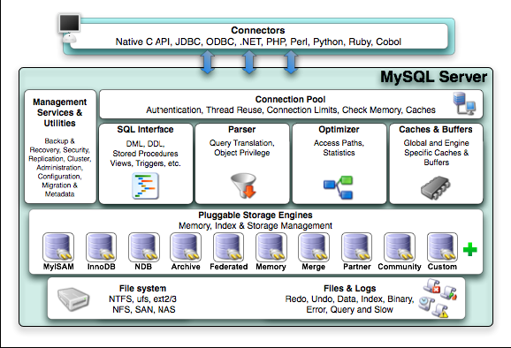

MYSQL RDBMS
GIT 1201

Slide 27
WORKING WITH WAMP
WampServer is a Windows Web development environment for PHP, Apache and MySQL databases.
It helps web developers to work faster on the local computer before uploading the finished website files to cloud web hosting server
Double click on the file and follow the install process to install.
After the install process, run the Server.
It the status of the Server displays green, the server is active or online and ready for use.
GIT 1201

Slide 28
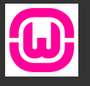
WORKING WITH WAMP…
If it does not show green, it means another application is perhaps using the same port as the WampServer,
In this case, you will need to close all applications and restart WampServer.
GIT 1201

Slide 29
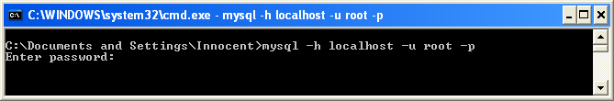
GETTING STARTED – USING MYSQL RDBMS
Logging into the mysql server
  Open the command prompt & enter the command below
  > mysql –h localhost –u root –p
  Viewing the available databases
  >show databases;
GIT 1201

Slide 30
GETTING STARTED – USING MYSQL RDBMS
Creating a database in MySQL
  >create database dreamhome;
Using a particular database
  >use dreamhome;
Viewing the tables in the database
  >show tables;
Deleting/dropping databases
  >drop database dreamhome;
GIT 1201

Slide 31
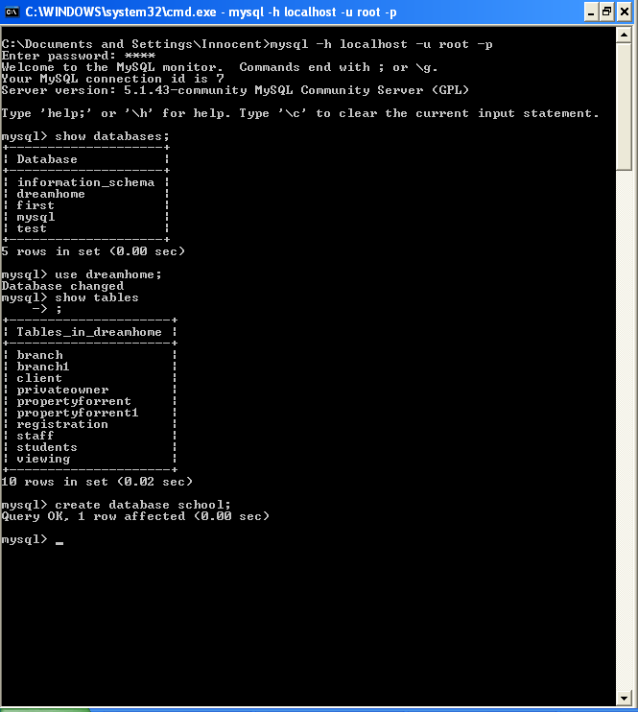
SAMPLE COMMANDS & OUTPUT
GIT 1201

Slide 32
CREATE TABLE
Creating tables is the first step in any SQL coding project.
Create is a DDL
It creates a table with one or more columns of the specified dataType.
  With NOT NULL, system rejects any attempt to insert a null in the column.
  Can specify a DEFAULT value for the column.
  Primary keys should always be specified as NOT NULL.
  FOREIGN KEY clause specifies FK along with the referential action.
GIT 1201

Slide 33
CREATE TABLE
Once you've set up your table, you start listing column names and data types in SQL.
Data types tell your database what information to expect for that column.
GIT 1201

Slide 34
CREATING A TABLE
Involves using the CREATE TABLE statement which includes:
  Specifying a table name [mandatory]
  Defining columns of the table [mandatory]
  Column name [mandatory]
  Column data type [mandatory]
  Primary key [mandatory]
  Column constraints [optional]
  Providing a default value [optional]
  Specifying table constraints [optional]
GIT 1201
4.<number>

Slide 35
SQL DATA TYPES
Working with databases of any kind means working with data.
This data can take a couple of predefined formats, data type.
  Data type - an attribute associated with a piece of data that tells a computer system how to interpret its value.
  It is a classification that indicates what a variable or object can hold in a computer programming
  Data types are an important factor is any programming language.
  Data types must be referenced and used correctly to ensure proper results and error free program.
GIT 1201

Slide 36
SQL DATA TYPES
CHARACTER (CHAR)
  defines a string of fixed length L.
CHARACTER VARYING ( VARCHAR)
  defines a string of varying length L.
DECIMAL(precision, scale) or NUMERIC(precision, [scale]):
  defines a number without an exact representation (fractions).
  Precision, an integer that speciﬁes the number of signiﬁcant digits
GIT 1201

Slide 37
SQL DATA TYPES…
  Scale, also an integer value speciﬁes the number of digits after the decimal point.
INTEGER and SMALLINT:
  deﬁnes numbers where the representation of fractions is not required.
DATE:
  stores date values in Julian date format as a combination of;
    YEAR (4 digits), MONTH (2 digits), and DAY (2 digits).
GIT 1201

Slide 38
CREATING TABLE SYNTAX
CREATE TABLE table_name
(
column_name data_type [column_constraint] [DEFAULT expr] , ….….
[, table_constraints]
)‏
Example - considering only mandatory specifications.
CREATE TABLE emp (emp_id number, name varchar(30));
GIT 1201

Slide 39
CREATE TABLE – USING THE DEFAULT OPTION
Example 1:
CREATE TABLE students
(regNo varchar(15), name varchar(20), dob date, gender char(1) default ‘M’);
Example 2:
  CREATE TABLE account
  (accountNo int primary key, balance numeric(8, 2));
  customer – (name, customerID, accountNo)
GIT 1201

Slide 40
EXERCISE
Write an SQL statement to create the following tables
  Branch(branchNo, street, city, postcode)‏
  Staff(staffNo, fName, lName, position, sex, DOB, salary)‏
GIT 1201

Slide 41
INSERTING DATA INTO THE TABLE
THE INSERT STATEMENT

Slide 42
INSERT
General Syntax:
INSERT INTO TableName [ (columnList) ]
  VALUES (dataValueList)
or
INSERT INTO "table_name" ("column1", "column2", ...)
VALUES ("value1", "value2", ...)
E.g. Inserting data into the Students’ Table
  INSERT INTO students
  VALUES('S001','Kanaye','1980-08-12', 'M');
GIT 1201

Slide 43
INSERT STATEMENT…
Notes:
columnList is optional; if omitted, SQL assumes a list of all columns in their original CREATE TABLE order.
Any columns omitted must have been declared as NULL when table was created, unless DEFAULT was specified when creating column.
dataValueList must match columnList as follows:
  number of items in each list must be same;
GIT 1201

Slide 44
INSERT STATEMENT…
  must be direct correspondence in position of items in two lists;
  data type of each item in dataValueList must be compatible with data type of corresponding column.
Insert a new row into Staff table supplying data for all columns.
GIT 1201

Slide 45
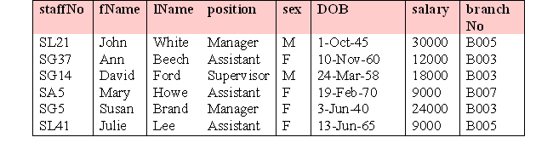
EXAMPLE 5.35 INSERT … VALUES
INSERT INTO Staff
  VALUES (‘SG16’, ‘Alan’, ‘Brown’, ‘Assistant’, ‘M’, ‘1957-05-25’, 8300, ‘B003’);
GIT 1201

Slide 46
EXERCISE
Write SQL statements to
  Create the table ‘Students’ shown below
  Insert the data in the table
regNo | fName | lName | course | age
S001 | Samuel | Kanaye | LLB | 20
S002 | Joy | Akello | CSC | 18
S003 | Edward | Ssekandi |  | 24
S004 | Arthur | Aropet | LLB | 21
S005 | Annet | Ajuna |  | 18
GIT 1201

Slide 47
SOLUTION
Decide on the data types for the different attributes. I.e.
  Find out the data types supported by MySQL DBMS
Attribute | Data type | FieldSize
regNo | Varchar | 10
fName | Varchar | 30
lName | Varchar | 30
course | Varchar | 10
Age | Integer
GIT 1201

Slide 48
SOLUTION CONT ….
Write SQL to create the table
  _________________________
Write SQL to insert data
  _________________________
Qn
  Can MySql Support Multiple Insert ?
GIT 1201

Slide 49
RETRIEVING DATA FROM THE DATABASE OBJECTS
USING THE SELECT STATEMENT

Slide 50
SELECT STATEMENT
  SELECT [DISTINCT | ALL]
  {* | [columnExpression [AS newName]] [,...] }
  FROM TableName [alias] [, ...]
  [WHERE condition]
  [GROUP BY columnList] [HAVING condition]
  [ORDER BY columnList]
Note:
  Order of the clauses cannot be changed.
  Only SELECT and FROM are mandatory.
GIT 1201

Slide 51
SELECT STATEMENT
FROM Specifies table(s) to be used.
WHERE Filters rows.
GROUP BY Forms groups of rows with same
  column value.
HAVING Filters groups subject to some
  condition.
SELECT Specifies which columns are to
  appear in output.
ORDER BY Specifies the order of the output.
GIT 1201

Slide 52
DATA RETRIEVAL FROM ONE TABLE
Four major scenarios of data retrieval from a single table:
    Retrieving all columns and all rows;
    Retrieving specific columns and all rows;
    Retrieving all columns and specific rows;
    Retrieving specific columns and specific rows.
GIT 1201

Slide 53
RETRIEVING ALL COLUMNS, ALL ROWS
Example 5.1 : List full details of all staff.
SELECT staffNo, fName, lName, address,
  position, sex, DOB, salary, branchNo
  FROM Staff;
Can use * as an abbreviation for ‘all columns’:
  SELECT *
  FROM Staff;
GIT 1201

Slide 54
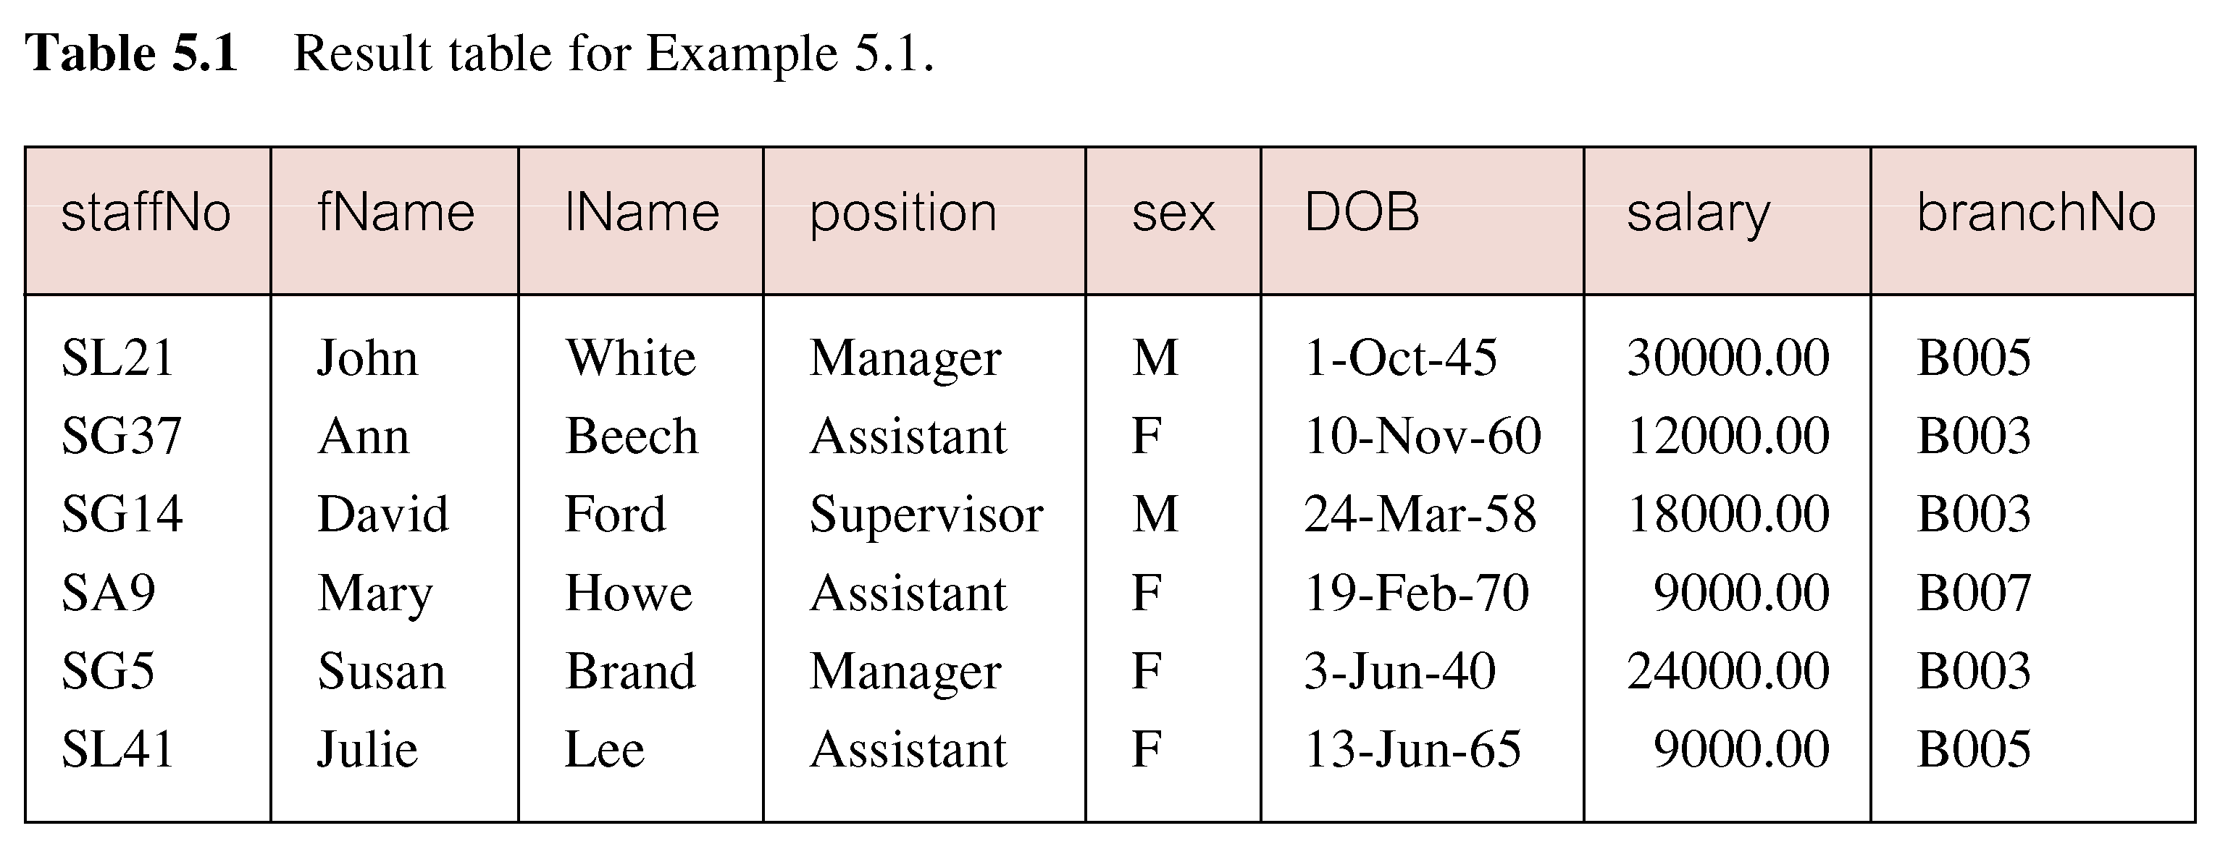
EXAMPLE 5.1 ALL COLUMNS, ALL ROWS CONT’D
GIT 1201

Slide 55
RETRIEVING SPECIFIC COLUMNS, ALL ROWS
Example 5.2 : Produce a list of salaries for all staff, showing only staff number, first and last names, and salary.
  SELECT staffNo, fName, lName, salary
  FROM Staff;
GIT 1201

Slide 56
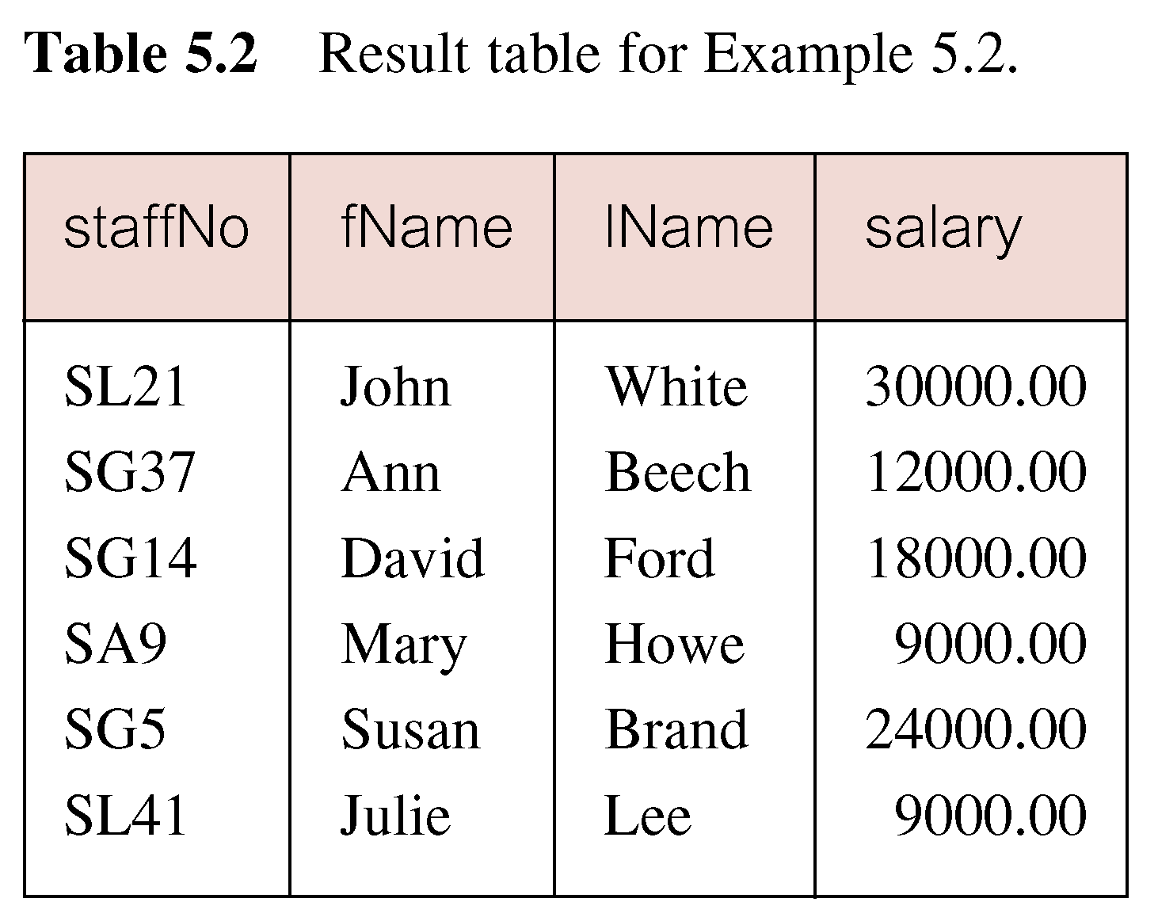
EXAMPLE 5.2 SPECIFIC COLUMNS, ALL ROWS CONT’D
GIT 1201

Slide 57
ROW SELECTION
The other 2 scenarios fall under the selection category i.e. specifying the rows one is interested in retrieving from a table (Row selection)
This is done using the WHERE clause. General syntax:
  SELECT clause
  FROM table
  WHERE condition;
Comparison operators are used to define conditions in the where clause.
GIT 1201

Slide 58
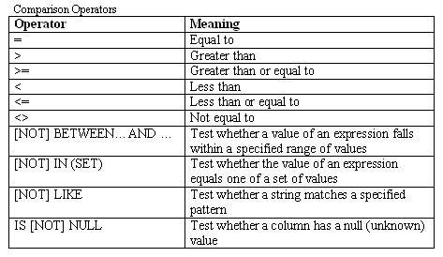
ROW SELECTION CONT’D
Note
    Character strings and dates in the where clause must be enclosed in single quotation marks (‘ ‘). Numeric constants should not be enclosed in single quotation marks.
    All character searches are case sensitive.
GIT 1201

Slide 59
ROW SELECTION CONT’D
More complex predicates can be generated using the logical operators
AND, OR, and NOT,
Use parentheses (if needed or desired) to show the order of evaluation.
The rules for evaluating a conditional expression are:
GIT 1201

Slide 60
ROW SELECTION CONT’D
  an expression is evaluated left to right;
  subexpressions in brackets are evaluated first;
  NOTs are evaluated before ANDs and ORs;
  ANDs are evaluated before ORs.
GIT 1201

Slide 61
RETRIEVING ALL COLUMNS AND SPECIFIC ROWS
Example 5.3: Produce a list of all staff members who are managers
  SELECT *
    FROM Staff
    WHERE position= ‘Manager';
GIT 1201

Slide 62
RETRIEVING SPECIFIC COLUMNS AND SPECIFIC ROWS
Example 5.4: Produce a list of the staffNo, first and last name all staff members who are managers
  SELECT staffno, fname, lname
  FROM Staff
  WHERE position = ‘Manager’;
GIT 1201

Slide 63
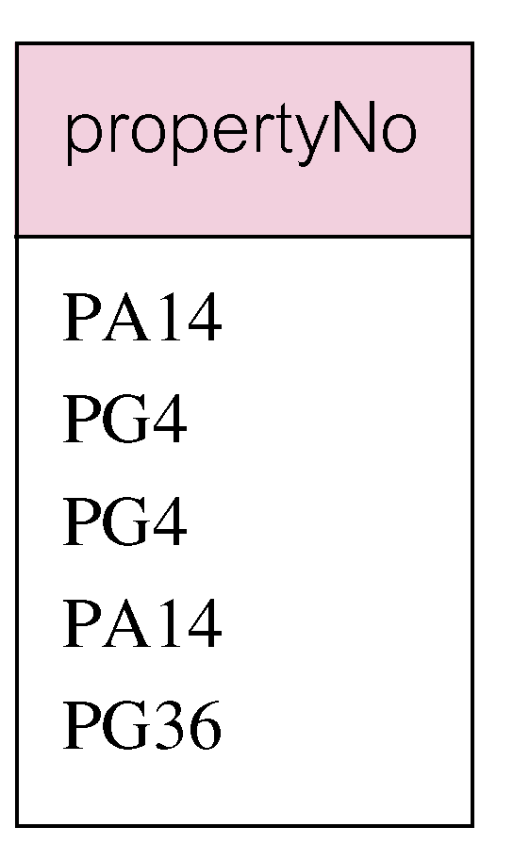
SELECTION USE OF DISTINCT KEYWORD
The DISTINCT Keyword is used to eliminate duplicates:
Example 5.5a : List the property numbers of all properties that have been viewed.
SELECT propertyNo
  FROM Viewing;
GIT 1201

Slide 64
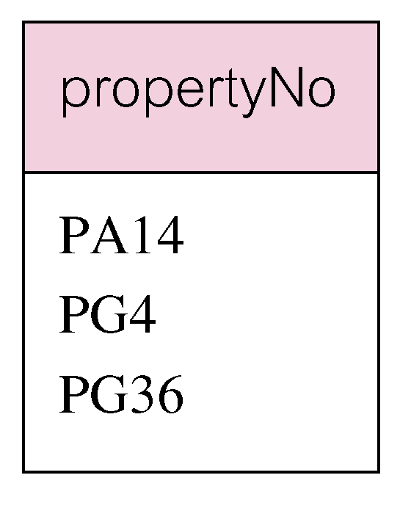
SELECTION USE OF DISTINCT KEYWORD CONT’D
Example 5.5b: List of distinct property numbers of all properties that have been viewed.
SELECT DISTINCT propertyNo
  FROM Viewing;
GIT 1201

Slide 65
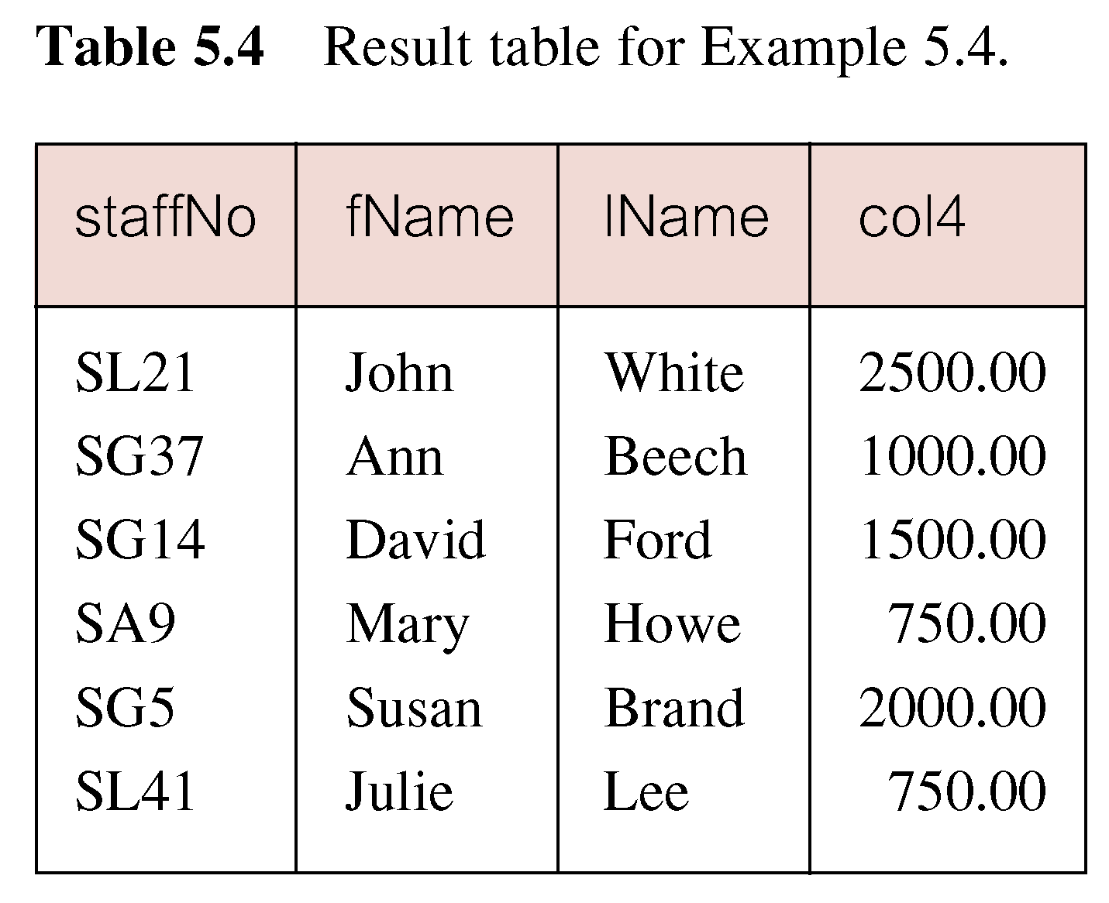
SELECTION WITH CALCULATED FIELDS
Example 5.6a Produce list of monthly salaries for all staff, showing staff number, first and last name, and salary.
SELECT staffNo, fName, lName, salary/12
  FROM Staff;
  N.B: Col4 = salary/12
GIT 1201

Slide 66
SELECTION WITH CALCULATED FIELDS CONT’D
Example 5.6b: To name column, use AS clause:
SELECT staffNo, fName, lName, salary/12
  AS monthlySalary
  FROM Staff;
Note: Column Aliase
  Another name given to a column with the purpose of making it more descriptive
  Given using the AS keyword or a space between the column name and the new name.
  Double quotation marks must be used when the aliase has spaces, is case sensitive or has special characters.
GIT 1201

Slide 67
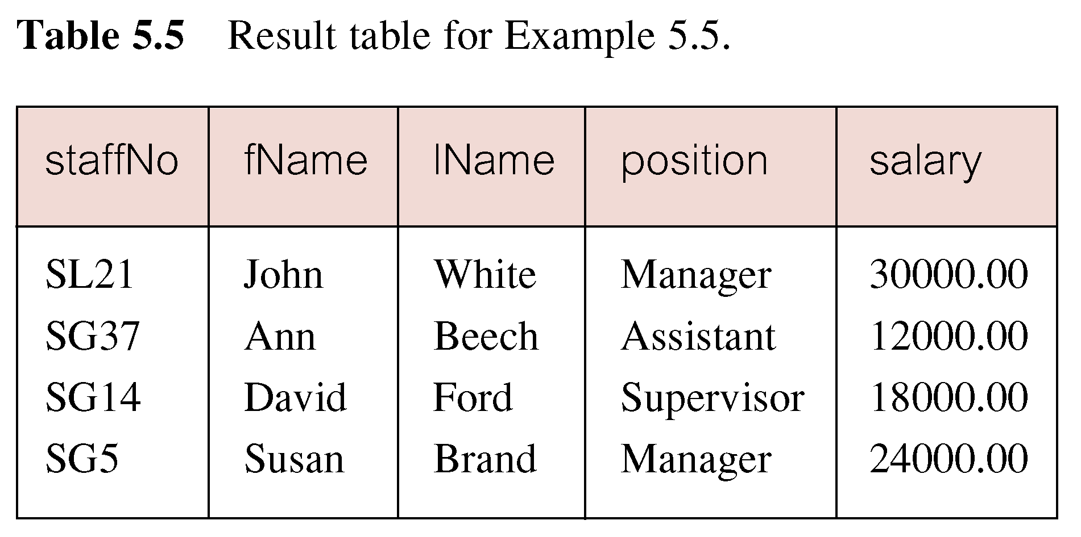
SELECTION USING A COMPARISON SEARCH CONDITION
Example 5.7: List all staff with a salary greater than 10,000.
SELECT staffNo, fName, lName, position, salary
  FROM Staff
  WHERE salary > 10000;
GIT 1201

Slide 68
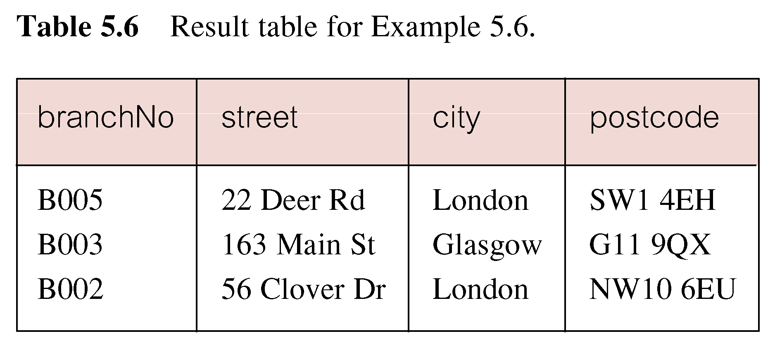
SELECTION WITH COMPOUND COMPARISON SEARCH CONDITION
Example 5.8: List addresses of all branch offices in London or Glasgow.
    SELECT *
  FROM Branch
  WHERE city = ‘London’ OR city = ‘Glasgow’;
GIT 1201

Slide 69
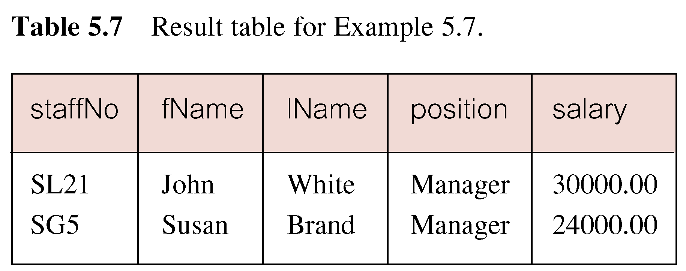
SELECTION WITH A RANGE SEARCH CONDITION
Example 5.9: List all staff with a salary between 20,000 and 30,000.
  SELECT staffNo, fName, lName, position, salary
    FROM Staff
    WHERE salary BETWEEN 20000 AND 30000;
GIT 1201

Slide 70
SELECTION WITH A RANGE SEARCH CONDITION CONT’D
Also a negated version is NOT BETWEEN.
BETWEEN does not add much to SQL’s expressive power. Could also write:
  SELECT staffNo, fName, lName, position, salary
    FROM Staff
    WHERE salary>=20000 AND salary <= 30000;
Useful, though, for a range of values.
GIT 1201

Slide 71
PATTERN MATCH SEARCH CONDITIONS
Find all owners with the string ‘Glasgow’ in their address.
For this query, search for the string ‘Glasgow’ appearing within the address column of the PrivateOwner table.
SQL has two special pattern-matching symbols:
  The % percent character represents any sequence of zero or more characters (wildcard).
  The _ underscore character represents any single character.
GIT 1201

Slide 72
PATTERN MATCH SEARCH CONDITIONS…
All other characters in the pattern represent themselves. For example:
  address LIKE ‘H%’ means the first character must be H, but the rest of the string can be anything.
  address LIKE ‘H_ _ _’ means that there must be exactly four characters in the string, the first of which must be an H.
  address LIKE ‘%e’ means any sequence of characters, of length at least 1, with the last character an e.
  address LIKE ‘%Glasgow%’ means a sequence of characters of any length containing Glasgow.
GIT 1201

Slide 73
PATTERN MATCH SEARCH CONDITIONS…
  address NOT LIKE ‘H%’ means the first character cannot be an H.
If the search string can include the pattern-matching character itself,
Use an escape character to represent the pattern-matching character.
For example, to check for the string ‘15%’,
Use the predicate:
LIKE ‘15#%’ ESCAPE ‘#’
GIT 1201

Slide 74
PATTERN MATCH SEARCH CONDITIONS…
Note
  Some RDBMSs, such as Microsoft Office Access, use the wildcard characters * and ? instead of % and _ .
GIT 1201

Slide 75
NULL SEARCH CONDITION
List the details of all viewings on property PG4 where a comment has not been supplied.
A null comment is considered to have an unknown value,
We cannot test whether it is equal or not equal to another string.
If we execute the SELECT statement using either of these compound conditions,
we would get an empty result table.
Test for null explicitly using the special keyword IS NULL:
GIT 1201

Slide 76
NULL SEARCH CONDITION
  SELECT clientNo, viewDate
  FROM Viewing
  WHERE propertyNo = ‘PG4’ AND comment IS NULL;
GIT 1201

Slide 77
CONCLUSION
What is SQL?
What is MySQL?
SQL Rules & MySQL Syntax
What data types are supported by MySQL DBMS???
Data definition (Creating tables)
Data Manipulation (Using SELECT)
Please do enough practice to master SQL statements.
GIT 1201

